Slide 1
Resource Allocation via Integer Programming
The Student Project Allocation problem

Slide 2
Introduction to Resource Allocation Problems
What is a Resource Allocation problem?
Ubiquitously across varied industries
Optimal distribution of finite resources _{[1]}
Examples:
Generally: Facility Location Problem
EEE: Computer Resource Allocation
Higher Education Institutions: SPA
Notes:
Generally:
How does amazon optimize positioning of fulfilment centers to demand points?
Production manufacturing, how do we assign tasks to machines or worker to machines
In EEE:
resource allocation is necessary for any application to be run on the system. When the user opens any program this will be counted as a process, and therefore requires the computer to allocate certain resources for it to be able to run.
In Education:
Allocating students to public high school in New York
Allocating students to public universities in France/Turkey
In University:
1.
2.

Slide 3
SPA Problem
Current Challenges
Automation_{[2]}
Speed of Execution_{[5]}
Student Satisfaction_{[3]}
Lecturer Satisfaction_{[4]}

Slide 4


Existing Solutions
Current EEE
Departmental Algorithm
Hungarian Method
Complete Enumeration
Uses gradient descent to maximise student satisfaction
[2]
[3]
Disadvantages
Minor manual intervention
Naive objective functions
Takes too long
N/N_{max} = Number of operations
n = number of students/projects
Notes:
EEE Algo.
Hungarian
Simple - doesn’t enable multi-objectives
Naive objective function - doesn’t enable any constraints
x14 slower than M2 with equivalent objective function
Enumeration

Slide 5
Binary Integer Programming (BIP) Approach

Slide 6
Model 2
Model 3
Objective Function:
Allocate based on preference rankings
Objective Function:
Allocate based on preference rankings
+ upper-bound on number of projects each lecturer can supervise (T_{PS})

Slide 7
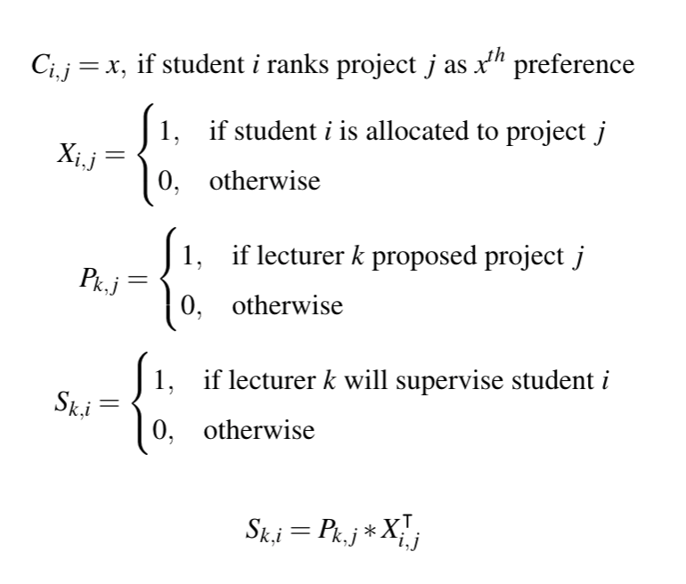
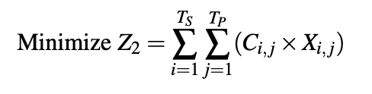
Model 2 : Decision Variables & Objective Function
Preference Matrix
Allocation Matrix
Objective Function, Z₂
T_{S} : Total number of students
T_{P}: Total number of projects

Slide 8
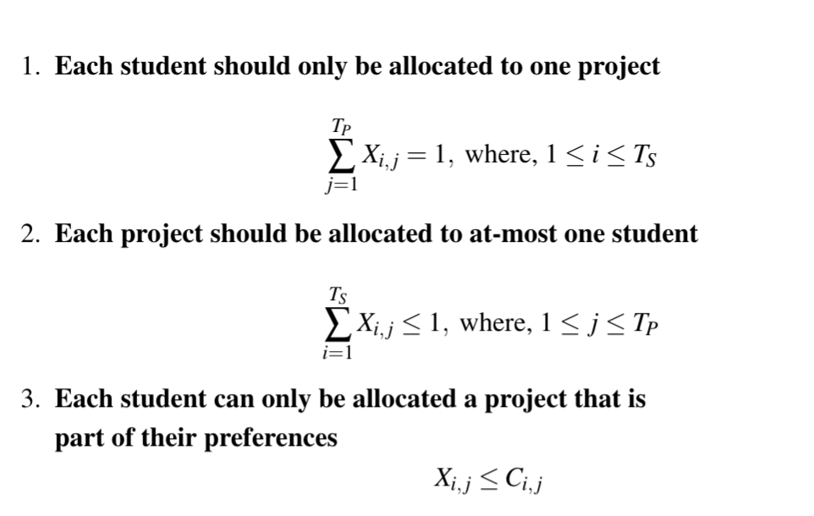
Model 2 : Constraints
Notes:
Use inequality
Use equality

Slide 9
Model 3 : Added Lecturer Constraint
Project Proposal Matrix
Supervision Matrix
Calculated by:

Slide 10
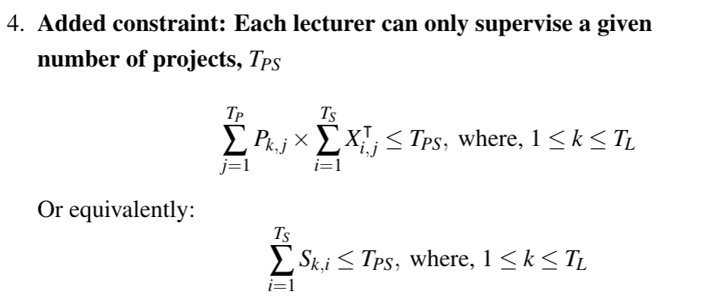
Model 3 : Lecturer Constraint
T_{PS} : Total number of projects each lecturer can supervise
T_{L} : Total number of lecturers

Slide 11
Data Specification
Exclusions
Data Post Exclusions
Self-proposed project students
Student allocated DoC projects
Student allocated projects after splitting popular projects into two/three
Students : 109
Projects: 181
Supervisors : 57

Slide 12
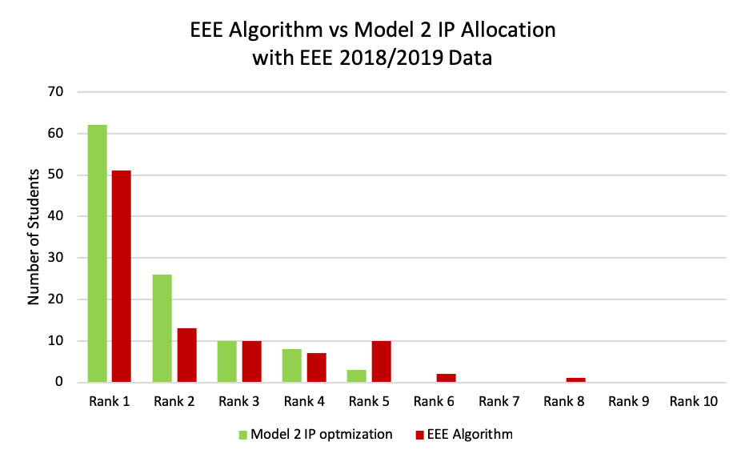
Rankings: Current EEE Algorithm vs Model 2
Notes:
Satisfaction rates: 78.7% to 89.9% resulting to 11.2% INCREASE
(With interference whereby 15 students where allocated to projects split post allocation, the algorithm achieves 81.65% which is Model 3 at TPS = 3 i.e the lecture-optimal solution.)

Slide 13
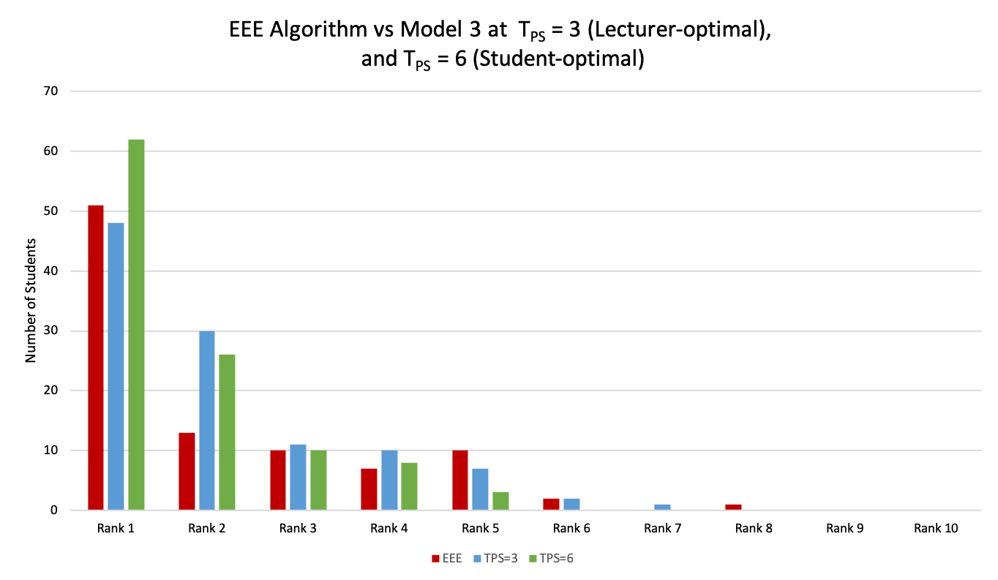
Rankings: Current EEE Algorithm vs Model 3
Notes:
TPS = 3
Student Satisfaction : 81.65%
Max Rank: 7
**************************************************
TPS = 6
Student Satisfaction : 89.91%
Max Rank: 5

Slide 14
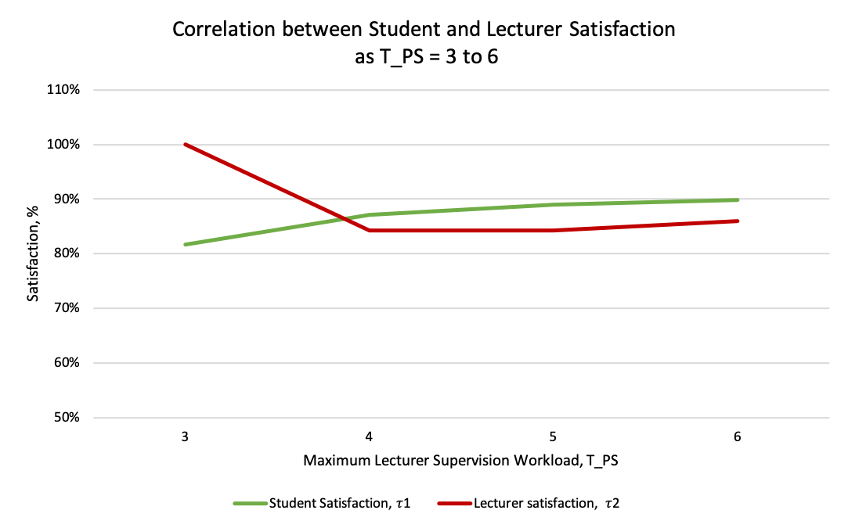
Student vs Lecturer Satisfaction

Slide 15
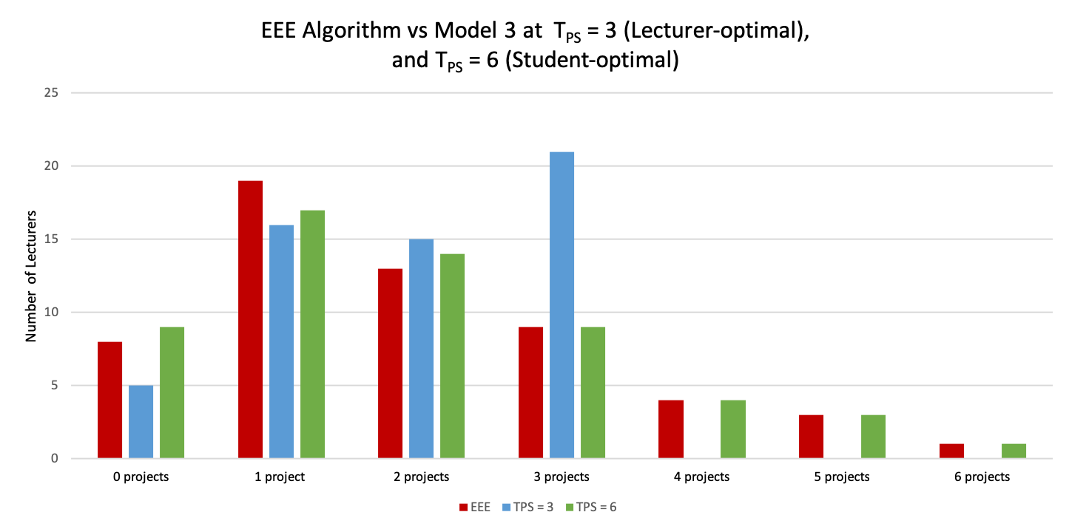
Lecturers : Current EEE Algorithm vs Model 3
Notes:
TPS = 3
Lecturer Satisfaction: 100%
**************************************************
TPS = 6
Lecturer Satisfaction: 85.96%

Slide 16
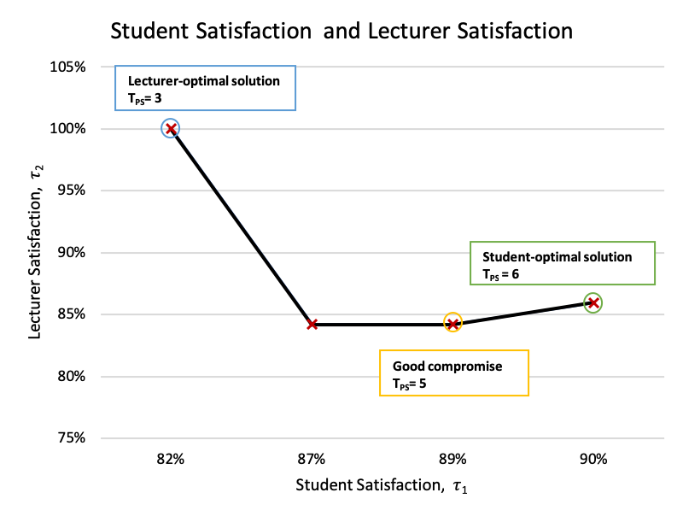
Student-optimal vs Lecturer-optimal Solutions

Slide 17
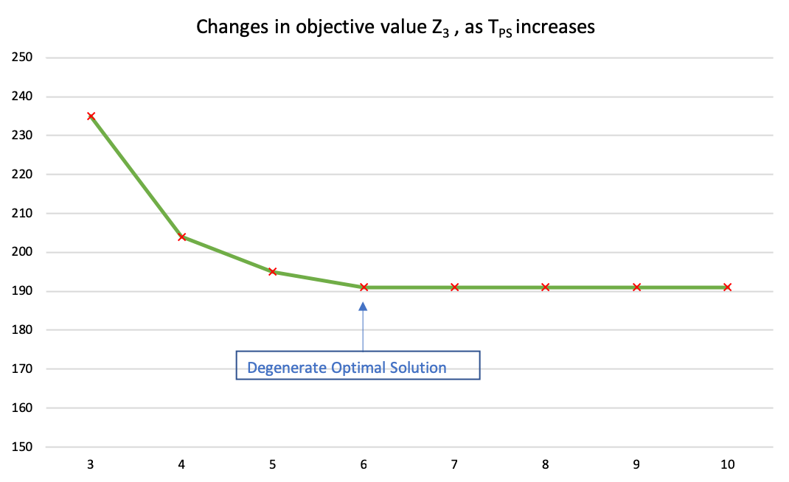
Objective Function

Slide 18
Satisfaction
EEE Dep. Algorithm
Model 3 at T_{PS}= 3
Model 2 / Model 3 at T_{PS}= 6
Student Satisfaction
Lecturer Satisfaction
90%
78.72%
81.65%
89.91%
87.72%
100%
85.96%
Notes:
Model 2 is the same as Model 3 at T_{PS}= 3

Slide 19
Computational Execution Time
BIP SPA Model 2
BIP SPA Model 3
Hungarian Method
5s
50s
70s
Current Algorithm
Complete Enumeration
5m
6.74d

Slide 20
Other Applications of BIP Approach
MODEL 2
Vehicle Routing:
Taxi Firms in Urban Cities
MODEL 2
Hospital/Residents Problem:
Resident-Optimal
Added constraint
MODEL 3
Job/Worker Problem:
Corporate Sector

Slide 21
Drawbacks & Achievements
Drawbacks
Achievements
More difficult to model
Computationally more difficult to solve compared to linear programs
Python PuLP implementation cannot support multi-objective that more complex resource allocation problems may require
Automated Efficient allocation
Fast
Adaptable
Large-scale Solution
Notes:
3. However, it is vital to consider existing literature and research on the SPA problem has shown that the majority of the existing algorithms for the SPA problem that use linear programming will only produce an approximate solution Whereas, the BIP approach is capable of producing optimal solutions to a range of optimization problems, even those that are NP-hard ( "at least as hard as the hardest problems in NP")
NP - solvable by a non-deterministic Turing machine in polynomial time

Slide 22

Demo

Slide 23
Acknowledgements
I would like to acknowledge the help of Prof. Astolfi without whom this project would not have been successful, and Dr. Clarke for his assistance on acquiring current SPA data.

Slide 24
Thank you - Questions?

Slide 25
References
[1] (June 6) Operations Research: Resource allocation;. Available: https://www.britannica.com/topic/operations-research/Resource-allocation.
[2] David F. Manlove and Gregg O’Malley. Student-project allocation with preferences over projects. Journal of Discrete Algorithms, 6(4):553–560, 2008. doi: 10.1016/j.jda.2008.07.003. URL https://www.sciencedirect.com/science/article/pii/S1570866708000476
[3] Raúl Calvo-Serrano, Gonzalo Guillén-Gosálbez, Simon Kohn, and Andrew Masters. Mathematical programming approach for optimally allocating students’ projects to academics in large cohorts. Education for Chemical Engineers, 20:11–21, Jul 2017.oi: 10.1016/j.ece.2017.06.002. URL https://www.sciencedirect.com/science/article/
pii/S1749772817300301.
[4]A. A. Anwar and A. S. Bahaj. Student project allocation using integer programming. IEEE Transactions on Education, 46(3):359–67, 2003. doi: 10.1109/TE.2003.811038. URL http://dx.doi.org/10.1109/TE.2003.811038.
[5]A. Kwanashie, R.W. Irving, D.F. Manlove, and C.T.S. Sng. Profile-based optimal matchings in the student–project allocation problem. In Proceedings of IWOCA ’14:the 25th International Workshop on Combinatorial Algorithms, volume 8986 of Lecture Notes in Computer Science, pages 213–225, 2015.
[6] Athanasios Vasilopoulos. The assignment problem: Searching for an optimal and efficient solution. Journal of Business and Economics, 6(1):1–12, Jan 20, 2015. doi:10.15341/jbe(2155-7950)/01.06.2015/001.
[7] (May 25). Introduction to Linear Algebra and Multivariable Calculus Spring - The Assignment Problem and the Hungarian Method. Available: http://www.math.harvard.edu/archive/20_spring_05/handouts/assignment_overheads.pdf.

Slide 26
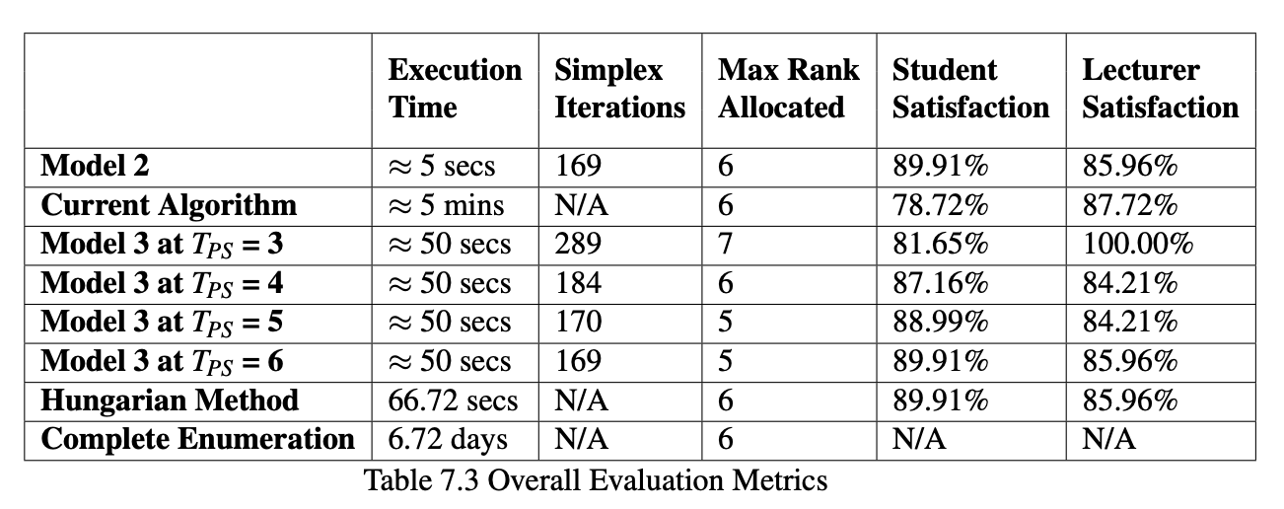
Overall Results

Slide 27
Model 1
Model 2
Objective Function:
Naively allocate projects to students based solely on their preferences.
Objective Function:
Allocate projects to students based on their preference rankings.

Slide 28
Model 3
Model 4
Objective Function:
Allocate projects to students based on their preference rankings whilst putting an upper-bound T_{PS}, on the number of projects each lecturer can supervise.
This is a non-dynamic approach.
Objective Function:
Allocate projects to students based on their preference rankings whilst putting an upper-bound 𝛃_{k}, on the number of projects lecturer k is allowed to supervise.

Slide 29
Model 5
Model 6
Objective Function:
Allocate projects based on minimizing the number of projects each lecturer supervises.
Objective Function:
Allocate projects to students based on their preference rankings whilst minimizing the number of projects each lecturer supervises.
This is a dynamic approach.

Slide 30
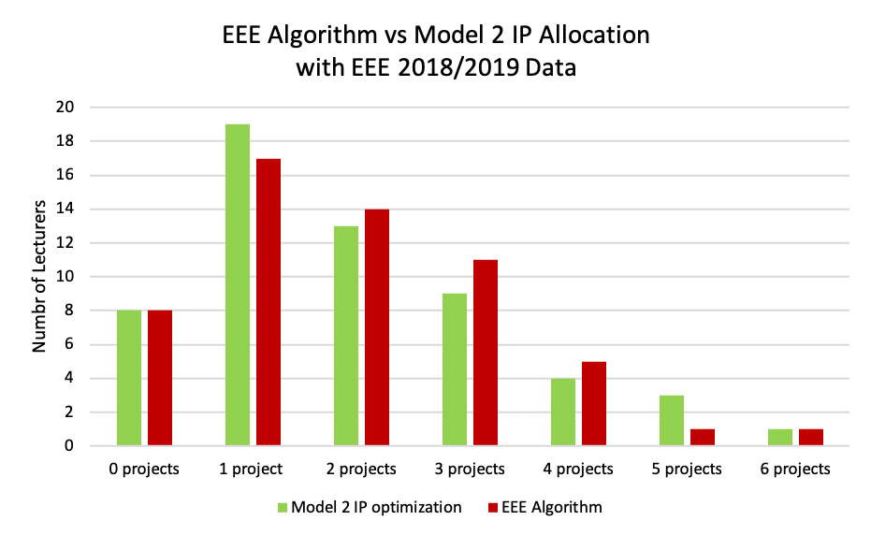
Lecturers : Current EEE Algorithm vs Model 2
Notes:
Tradeoff is the lecturer satisfaction rates: 87.72% to 85.96% resulting to 1.76% DECREASE not much generally but translates to 2 more lecturers supervising 5 projects in this case which is negatively impactful to them

Slide 31
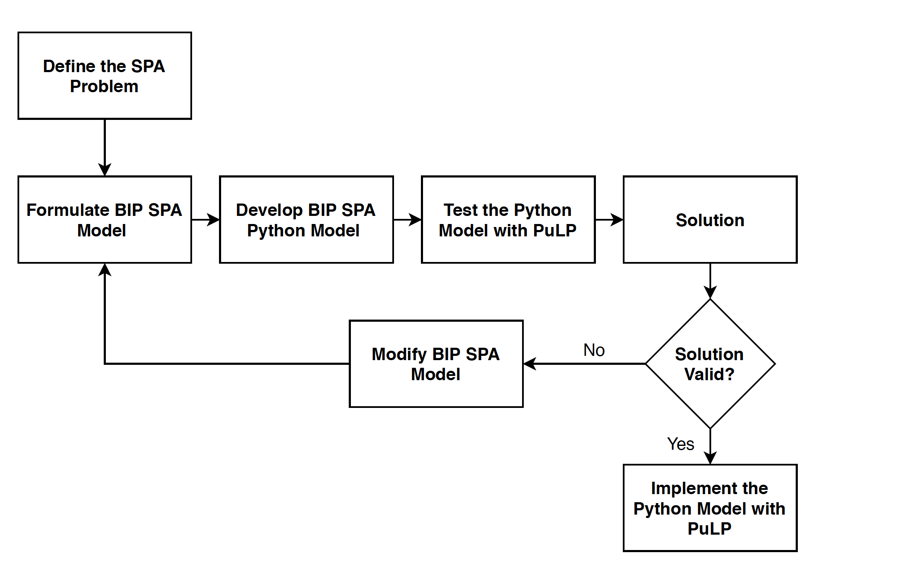
Introduction to SPA Problem

Slide 32
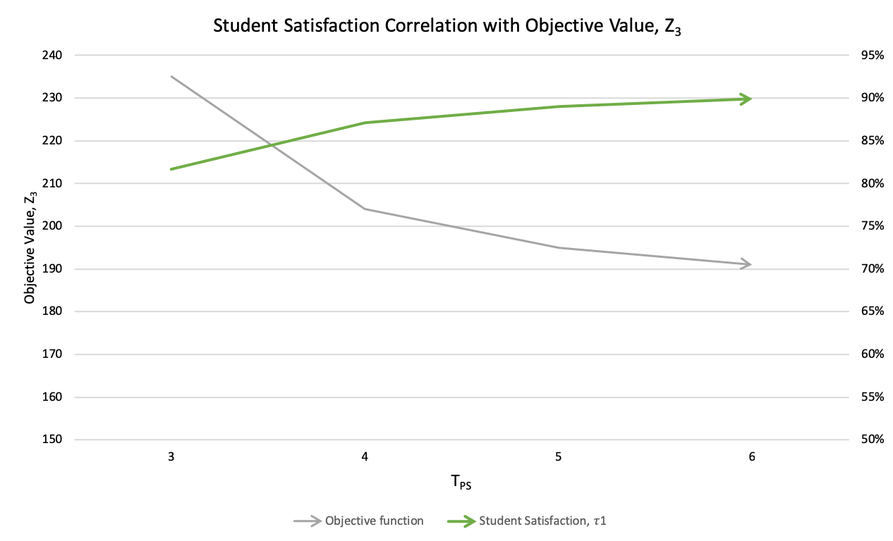
Student Satisfaction vs Objective Function

Slide 33
Motivation
Optimize the SPA problem using BIP
to maximise student and lecturer satisfaction during the allocation process

